Slide 1
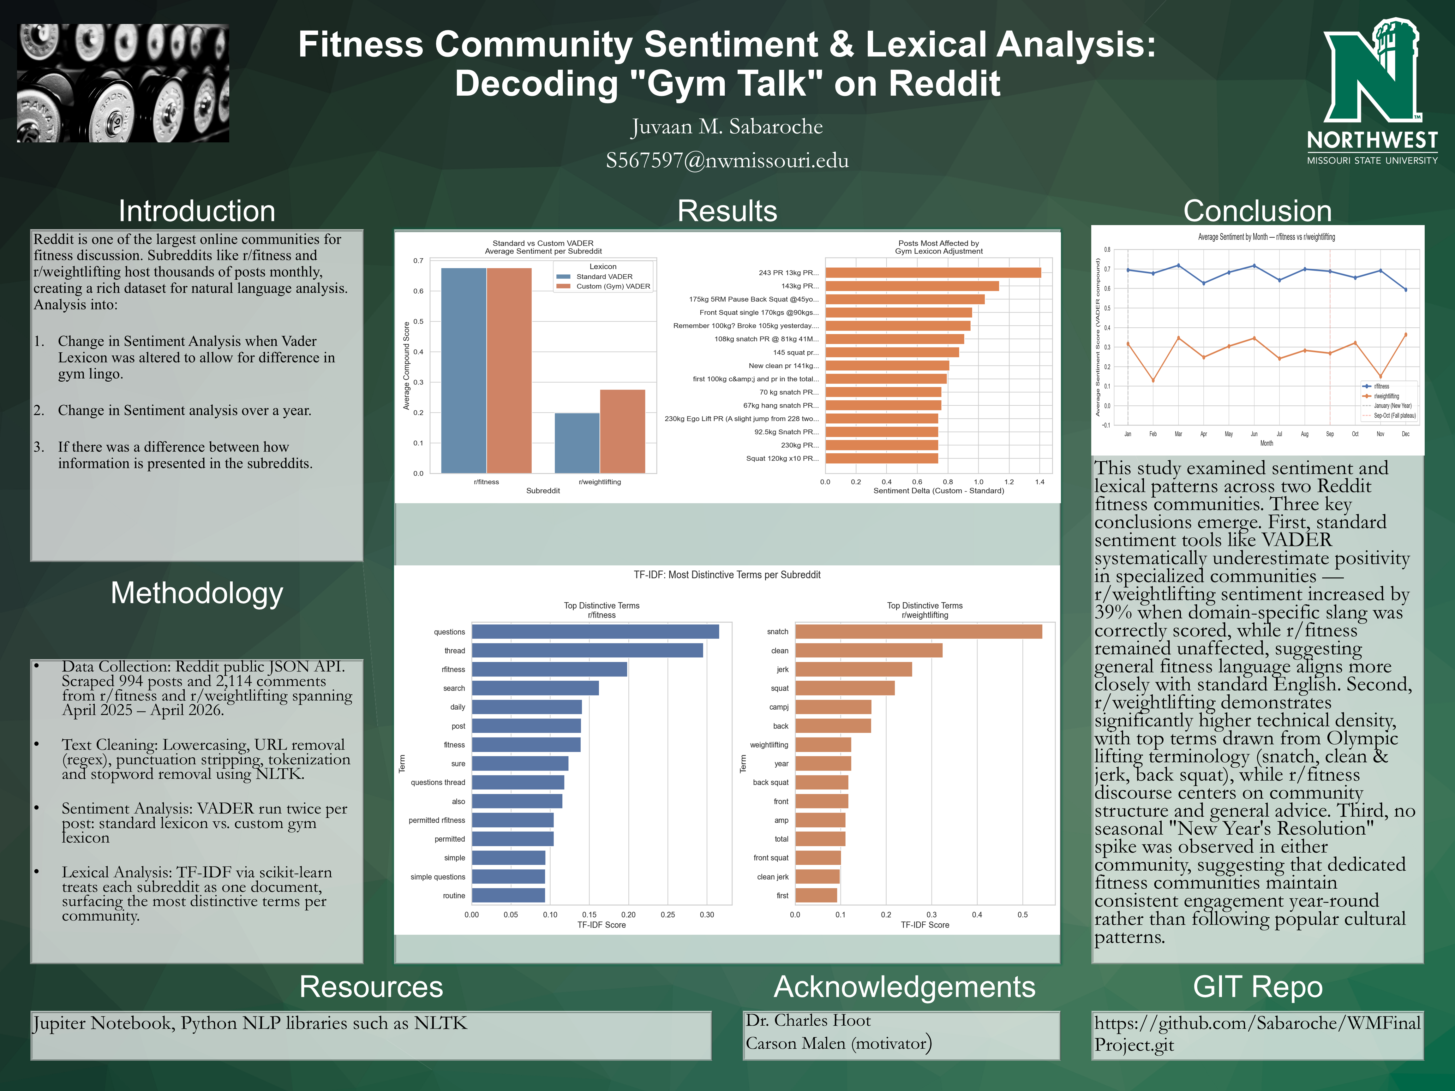

Slide 2
Overview
994
2,114
12 Months
Posts Collected
Comments Collected
Date Range
r/fitness + r/weightlifting
Top-level comments
Apr 2025 – Apr 2026
Research Questions
Most Important Finding
Gym Talk Inversion: Does adjusting VADER for gym slang meaningfully change sentiment scores?
Seasonal Sentiment: Do fitness communities show a measurable January spike or fall plateau?
Technical Density: Does r/weightlifting use more specialized jargon than r/fitness?
Standard sentiment tools underestimate positivity in specialized communities.
r/weightlifting sentiment increased by 39% when gym-specific slang was correctly scored, while r/fitness was completely unaffected. This confirmed the hypotheses that topic specific lexicons are needed for accurate NLP analysis of niche online communities.
Northwest Missouri State University | Web Mining Final Project

Slide 3
Raw Data
Where & How
Data Available
Post Title
Primary text for sentiment & TF-IDF analysis
Source Reddit public JSON API — no API key required. Data was fetched directly from Reddit's publicly accessible endpoints using Python's requests library. Subreddits r/fitness (general fitness community) r/weightlifting (Olympic lifting specialists) Extraction Method Reddit returns results in pages of 25 posts. The scraper looped through pages using pagination cursors, collecting top posts from the past year. Comments were fetched per post using the same JSON endpoint.
Post Body
Extended content, cleaned and tokenized
Timestamp
Converted to date/month for seasonal analysis
Upvote Score
Engagement weight (used as stretch goal)
Comment Count
Volume of discussion per post
Top Comments
10 top-level comments per post collected
Northwest Missouri State University | Web Mining Final Project

Slide 4
Processing & Statistics
Processing Steps
Statistics Examined
01
Text Cleaning
VADER Compound Score
0.676
Lowercased text, removed URLs (regex), punctuation stripped, tokenized with NLTK, stopwords removed.
Primary sentiment score per post, ranging from -1 (most negative) to +1 (most positive). Computed under both standard Vader and custom gym lexicons.
r/fitness
0.199
r/weightlifting std
02
0.277
Custom Gym Lexicon
15 gym-specific terms overriding VADER scores. E.g. 'brutal' +3.0, 'plateau' -2.0.
r/weightlifting custom
Sentiment Delta
1.40
Difference between custom and standard VADER scores per post. High delta = post contained gym slang being misread by standard VADER.
Max delta observed
+0.078
03
Dual VADER Scoring
Avg delta (weightlifting)
Each post scored twice: standard and custom VADER. Delta column recorded the shift per post.
TF-IDF Score
questions
Ranked the most distinctive terms per subreddit. Higher score = more uniquely important to that community vs. the other.
Top r/fitness term
04
TF-IDF Analysis
snatch
TfidfVectorizer identified the most distinctively used terms per subreddit
Top r/weightlifting term
Monthly Average Sentiment
05
0.60 – 0.72
Monthly Grouping
Average compound score grouped by calendar month for each subreddit, used to test the seasonal sentiment hypothesis.
r/fitness range
Posts grouped by UTC timestamp month to compute average sentiment trends across the year.
0.13 – 0.37
r/weightlifting range
Northwest Missouri State University | Web Mining Final Project

Slide 5
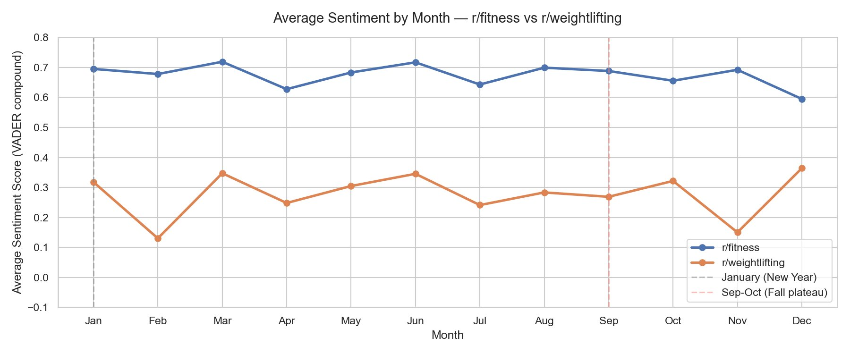
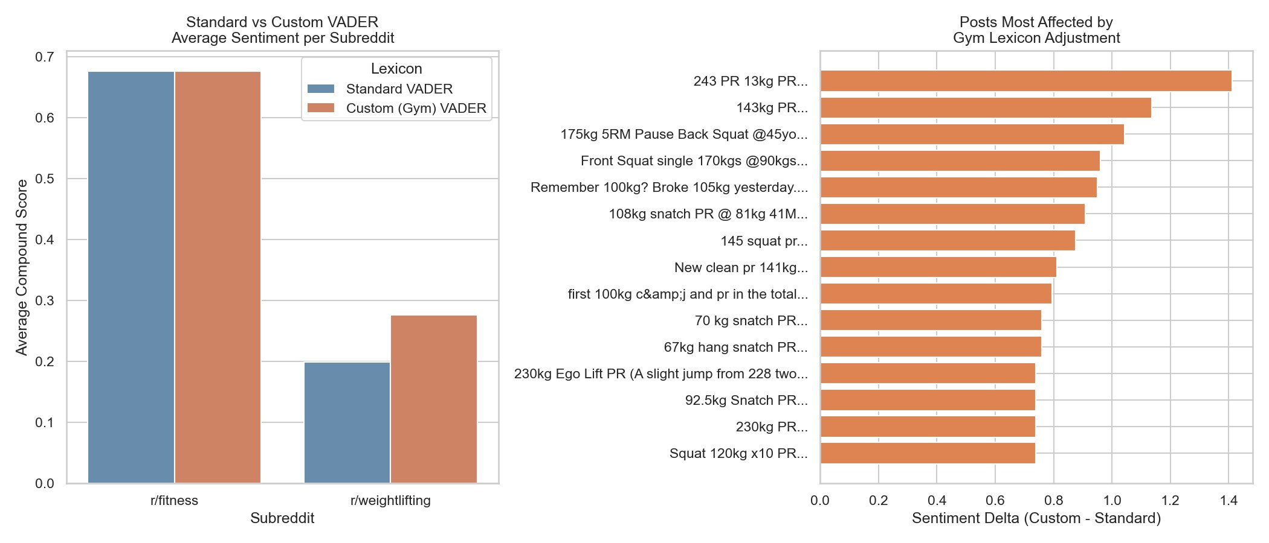
Conclusions
Gym Talk Inversion
RQ1: Does adjusting VADER for gym slang change sentiment scores?
Conclusions
✓
Going into this project we had 3 questions. And these are the conclusions we were able to gain and visualize.
RQ1: Inconclusive. It showed a difference within r/weightlifting and no difference in r/fitness, which may suggest that it may have greater effect on niche communities. So, in the future, testing other niche communities may give us a better picture
✓
RQ2: No measurable January spike or fall plateau was found in either subreddit. r/fitness maintained consistently high sentiment (0.60–0.72) year-round. r/weightlifting showed greater variability (0.13–0.37) likely tied to competition cycles, not seasons. Will look into other communities to know if that analysis remains apparent.
RQ3: r/weightlifting top terms: snatch, clean, jerk, back squat, front squat — all Olympic lifting movements. r/fitness top terms: questions, thread, routine, search — general community language. Specialized communities develop and consistently use a denser technical vocabulary.
Northwest Missouri State University | Web Mining Final Project

